Slide 1

Statistics
Ruth Mburu

Slide 2

Topics
One sample t test
One sample z test
Chi square test
Covariance, Pearson correlation, Spearman rank correlation
Inferential stats with python

Slide 3

One Sample t-test
One would use a one sample t test to evaluate a population mean using a single sample. Usually, you conduct this hypothesis test to determine whether a population mean differs from a hypothesized value you specify. The hypothesized value can be theoretically important in the study area, a reference value, or a target.
For example, a beverage company claims its soda cans contain 250ml. A researcher randomly samples their cans and measures the amount of fluid in each one. A one-sample t-test can use the sample data to determine whether the entire population of soda cans differs from the hypothesized value of 12-ounces.

Slide 4
One Sample T Test Hypotheses
A one sample t test has the following hypothesis:
Null hypothesis (H₀): The population mean equals the hypothesized value (µ = H₀)
Alternative hypothesis (H_{A}): The population mean does not equal the hypothesized value (µ≠ H₀)
If the p-value is less than your significance level (e.g. 0.05), you can reject the null hypothesis. The difference between the sample mean and the hypothesized value is statistically significant. Your sample provides strong enough evidence to conclude that the population mean does not equal the hypothesized value.

Slide 5
One Sample T Test Assumption
For reliable one sample t test results, your data should satisfy the following assumptions:
Random Sample
Drawing a random sample from your target population helps ensure your data represent the population. Samples that don’t reflect that population tend to produce invalid results.
Continuous Data
One-sample t-tests require continuous data. These variables can take on any numeric value, and the scale can be split meaningfully into smaller increments. For example, temperature, height, weight, and volume are continuous data.

Slide 6
Normally distributed data or your sample has more than 20 observations
This hypothesis test assumes your data follow the normal distribution. However, your data can be mildly skewed when the distribution is unimodal and your sample size is greater than 20 because of the central limit theorem.
Be sure to check for outliers because they can throw off the results.
Independent Observations
The one-sample t-test assumes that observations are independent of each other, meaning that the value of one observation does not influence or depend on another observation’s value. Violating this assumption can lead to inaccurate results because the test relies on the premise that each data point provides unique and separate information.

Slide 7
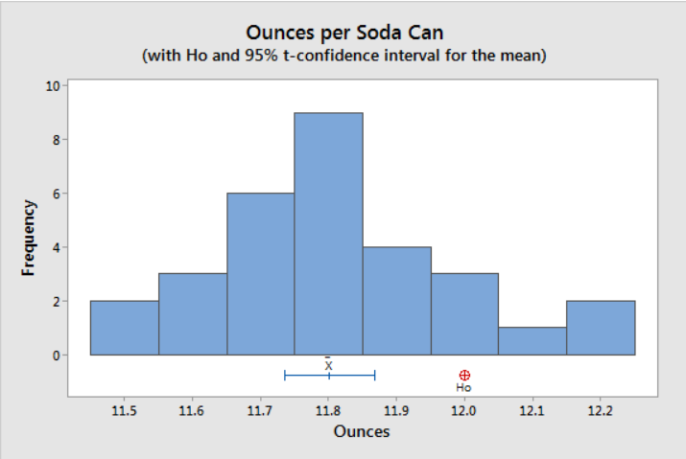
Example One Sample T Test
Let’s return to the 12-ounce soda can example and perform a one-sample t-test on the data. Imagine we randomly collected 30 cans of soda and measured their contents.
We want to determine whether the difference between the sample mean and the hypothesized value (12) is statistically significant.

Slide 8

The histogram shows the data are not skewed, and no outliers are present.

Slide 9

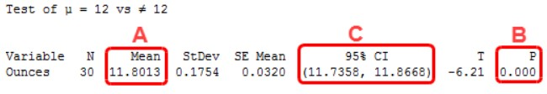


Interpreting the Results
Here’s how to read and report the results for a one sample t test.
The statistical output indicates that the sample mean (A) is 11.8013. Because the p-value (B) of 0.000 is less than our significance level of 0.05, the results are statistically significant. We reject the null hypothesis and conclude that the population mean does not equal 12 ounces. Specifically, it is less than that target value. The beverage company is underfilling the cans.
The confidence interval (C) indicates the population mean for all cans is likely between 11.7358 and 11.8668 ounces. This range excludes our hypothesized value of 12 ounces, reaffirming the statistical significance.

Slide 10

One sample z test
A Z test is a form of inferential statistics. It uses samples to draw conclusions about populations.
Use a Z test when you need to compare group means. Use the 1-sample analysis to determine whether a population mean is different from a hypothesized value.
For example, use Z tests to assess the following:
One sample: Do students in an honors program have an average IQ score different than a hypothesized value of 100?
A Z test is often the first hypothesis test students learn because its results are easier to calculate by hand and it builds on the standard normal distribution that they probably already understand.
Conversely, Z tests are too sensitive to mean differences in smaller samples and can produce statistically significant results incorrectly (i.e., false positives).

Slide 11

Z Test Hypotheses
This analysis uses sample data to evaluate hypotheses that refer to population means (µ). The hypotheses depend on whether you’re assessing one or two samples. At its most basic, a probability of an event occurring equals the following:
One-Sample Z Test Hypotheses
Null hypothesis (H₀): The population mean equals a hypothesized value (µ = µ₀).
Alternative hypothesis (H_{A}): The population mean DOES NOT equal a hypothesized value (µ ≠ µ₀).
When the p-value is less or equal to your significance level (e.g., 0.05), reject the null hypothesis. The difference between your sample mean and the hypothesized value is statistically significant. Your sample data support the notion that the population mean does not equal the hypothesized value.

Slide 12
Chi-Square Test of Independence
Introduction
The Chi-square test of independence determines whether there is a statistically significant relationship between categorical variables. It is a hypothesis test that answers the question—do the values of one categorical variable depend on the value of other categorical variables? This test is also known as the chi-square test of association.
Like any statistical hypothesis test, the Chi-square test has both a null hypothesis and an alternative hypothesis.
Null hypothesis: There are no relationships between the categorical variables. If you know the value of one variable, it does not help you predict the value of another variable.
Alternative hypothesis: There are relationships between the categorical variables. Knowing the value of one variable does help you predict the value of another variable.
If your observed distribution is sufficiently different than the expected distribution (no relationship), you can reject the null hypothesis and infer that the variables are related.
For a Chi-square test, a p-value that is less than or equal to your significance level indicates there is sufficient evidence to conclude that the observed distribution is not the same as the expected distribution. You can conclude that a relationship exists between the categorical variables.

Slide 13
Star Trek Fatalities by Uniform Colors
We’ll perform a Chi-square test of independence to determine whether there is a statistically significant association between shirt color and deaths. We need to use this test because these variables are both categorical variables. Shirt color can be only blue, gold, or red. Fatalities can be only dead or alive.
The color of the uniform represents each crewmember’s work area. We will statistically assess whether there is a connection between uniform color and the fatality rate. Believe it or not, there are “real” data about the crew from authoritative sources and the show portrayed the deaths onscreen. The table below shows how many crewmembers are in each area and how many have died.
Color | Areas | Crew
Blue | Science and Medical | 136 | 7
Gold | Command and Helm | 55 | 9
Red | Operations, Engineering, and security | 239 | 24
Ship’s total | All | 430 | 40

Slide 14
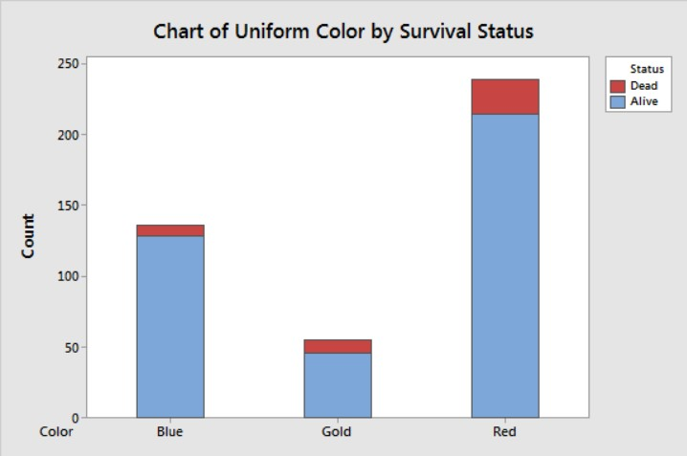
Chi test cont..
Tip: Because the chi-square test of association assesses the relationship between categorical variables, bar charts are a great way to graph the data. Use clustering or stacking to compare subgroups within the categories.

Slide 15
Covariance
Introduction
Covariance in statistics measures the extent to which two variables vary linearly. The covariance formula reveals whether two variables move in the same or opposite directions.
Covariance is like variance in that it measures variability. While variance focuses on the variability of a single variable around its mean, the covariance formula assesses the co-variability of two variables around their respective means. A high value suggests an association exists between the variables, indicating that they tend to vary together.
Interpreting Covariance
Interpreting covariance is challenging due to its wide range of possible results. Its formula allows values to range from negative infinity to positive infinity. The magnitude and scale of the variables strongly affect the covariance value, making it difficult to determine the strength of the relationship.

Slide 16
Interpreting Covariance cont..
Use covariance to assess the direction of the relationship but not its strength. This statistic can be categorized into positive and negative types, conveying a distinct association between variables.
Positive Value
When the covariance between two variables is positive, they tend to move in the same direction. Higher values of one variable tend to correspond with higher values of the other variable. For instance, if we observe a positive covariance between the number of hours spent studying and the corresponding grades achieved by students, it implies that increased study hours generally coincide with higher grades.
Negative Values
Conversely, a negative covariance signifies that the variables move in opposite directions. Higher values of one variable tend to correspond with lower values of the other variable. For instance, a negative value for rainfall and hours spent outdoors suggests that people tend to spend less time outside when it rains more.

Slide 17
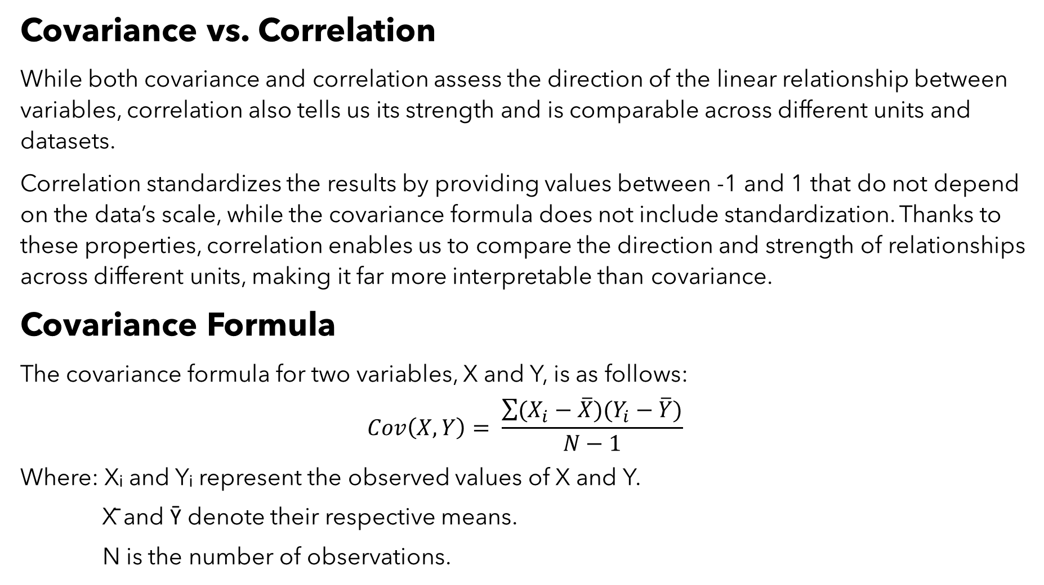
Covariance vs. Correlation
While both covariance and correlation assess the direction of the linear relationship between variables, correlation also tells us its strength and is comparable across different units and datasets.
Correlation standardizes the results by providing values between -1 and 1 that do not depend on the data’s scale, while the covariance formula does not include standardization. Thanks to these properties, correlation enables us to compare the direction and strength of relationships across different units, making it far more interpretable than covariance.
Covariance Formula
The covariance formula for two variables, X and Y, is as follows:
$$Cov\left(X,Y\right)= \frac{\sum{(X_{i}−\overline{X})(Y_{i}−\overline{Y})}}{N−1}$$
Where: Xᵢ and Yᵢ represent the observed values of X and Y.
X̄ and Ȳ denote their respective means.
N is the number of observations.

Slide 18
Covariance formula cont..
By understanding the covariance formula, you can gain insight into how it assesses the data. The formula works by comparing each variable’s observed values to their means.
The product in the formula’s numerator produces a greater number of positive values to add to the sum when the following conditions tend to occur:
Above-average X values correspond with above-average Y values.
Below-average X values correspond with below-average Y values.
A positive sum in the numerator produces a positive covariance.
Conversely, when above-average values for one variable tend to correspond with below-average values of the other, the numerator produces a greater number of negative values to subtract from the total. A negative sum in the numerator produces a negative covariance.
In this manner, the covariance formula assesses the co-variability of two variables around their respective means.

Slide 19
Calculating Covariance Example:
Suppose we want to evaluate the relationship between the number of hours studied (X) and the test scores (Y) obtained by a group of five students. The data are below.
To start, we need to find the mean of both variables to enter into the covariance formula.
X̄ = (3 + 5 + 2 + 7 + 4) / 5 = 4.2
Ȳ = (70 + 80 + 60 + 90 + 75) / 5 = 75
Hours (X) | Score (Y)
3 | 70
5 | 80
2 | 60
7 | 90
4 | 75

Slide 20
Example cont;
Then, follow these steps to calculate covariance:
1. Calculate the differences between the observed X and Y values and each variable’s mean.
2. Multiply those differences for each X and Y pair.
3. Sum those products.
4. Divide the sum by the degrees of freedom.
 | Hours(X) | Score(Y) | (Xi-X) | (Yi-Y) | Product
 | 3 | 70 | -1.2 | -5 | 6
 | 5 | 80 | 0.8 | 5 | 4
 | 2 | 60 | -2.2 | -15 | 33
 | 7 | 90 | 2.8 | 15 | 42
 | 4 | 75 | -0.2 | 0 | 0
Average | 4.2 | 75 |  | Total | 85
 |  |  |  | N-1 | 4
 |  |  |  | Covariance | 21.25

Slide 21
Example cont..;
The positive covariance (21.25) suggests a positive association between the number of hours studied and exam scores. This result implies that as the number of study hours increases, the scores tend to increase.
Covariance Application
Typically, you’ll report correlations instead of covariances due to the interpretation issues. However, despite those shortcomings, it has specialized applications in various fields, including finance, genetics, meteorology and oceanography.

Slide 22
Correlation
A correlation between variables indicates that as one variable changes in value, the other variable tends to change in a specific direction. A correlation coefficient measures both the direction and the strength of this tendency to vary together. Using the multiplication rule to calculate probabilities.
A positive correlation indicates that as one variable increases the other variable tends to increase.
A correlation near zero indicates that as one variable increases, there is no tendency in the other variable to either increase or decrease.
A negative correlation indicates that as one variable increases the other variable tends to decrease.
The correlation coefficient can range from -1 to 1.
The two most common types of correlation coefficients are Pearson’s product moment correlation and the Spearman rank-order correlation.

Slide 23

Pearson Correlation
The Pearson correlation evaluates the linear relationship between two continuous variables. A relationship is linear when a change in one variable is associated with a proportional change in the other variable.
Pearson’s correlation coefficient formula produces a number ranging from -1 to +1, quantifying the strength and direction of a relationship between two continuous variables. A correlation of -1 means a perfect negative relationship, +1 represents a perfect positive relationship, and 0 indicates no relationship.
Pearson’s Correlation Coefficient Formula
So, let’s take a look at the formula itself. The Greek symbol ρ (rho) represents Pearson’s correlation coefficient. The correlation coefficient formula is the following fraction:
$$ρ=\frac{\sum{(X_{i}−\overline{X})(Y_{i}−\overline{Y})}}{(n−1)s_{X}s_{Y}}$$

Slide 24

Pearson Correlation
Where:
Xᵢ and Yᵢ represent the individual values of variables X and Y.
X̄ and Ȳ denote their respective means.
N represents the number of observations.
sx and sy represent the sample standard deviations of X and Y.
How the Correlation Coefficient Formula Works
Numerator
The correlation formula works by comparing each variable’s observed values to their means in the numerator, as shown below.
$$\sum{(X_{i}−\overline{X})(Y_{i}−\overline{Y})}$$

Slide 25
Pearson Correlation
The product in the correlation coefficient formula’s numerator produces a greater number of positive values to add to the sum when the following conditions tend to occur:
Above-average X values correspond with above-average Y values.
Below-average X values correspond with below-average Y values.
A positive sum in the numerator produces a positive correlation.
Conversely, when above-average values for one variable tend to correspond with below-average values of the other, the numerator produces a greater number of negative values to subtract from the total. A negative sum in the numerator produces a negative correlation.

Slide 26

Pearson Correlation
Denominator
$$(n−1)s_{X}s_{Y}$$
The denominator of the correlation coefficient formula divides the numerator by the product of the degrees of freedom and the two standard deviations. The denominator is always positive because degrees of freedom and standard deviations are always positive values.
The numerator can be positive or negative but its absolute value can never be larger than the denominator, which is how the equation scales correlation coefficients to fit the range of -1 to +1.

Slide 27
Pearson Correlation
EXAMPLE
Suppose we want to evaluate the relationship between the number of hours studied (X) and the test scores (Y) obtained by a group of five students. The data are below;
Numerator
To start, we need to find the mean of both variables to use in the correlation formula.
X̄ = (3 + 5 + 2 + 7 + 4) / 5 = 4.2
Ȳ = (70 + 80 + 60 + 90 + 75) / 5 = 75
Hours (X) | Score (Y)
3 | 70
5 | 80
2 | 60
7 | 90
4 | 75

Slide 28
Pearson Correlation
EXAMPLE CONT..
Then, follow these steps to calculate the numerator in the correlation coefficient formula:
1. Calculate the differences between the observed X and Y values and each variable’s mean.
2. Multiply those differences for each X and Y pair.
3. Sum those products.
 | Hours(X) | Score(Y) | (Xi-X) | (Yi-Y) | Product
 | 3 | 70 | -1.2 | -5 | 6
 | 5 | 80 | 0.8 | 5 | 4
 | 2 | 60 | -2.2 | -15 | 33
 | 7 | 90 | 2.8 | 15 | 42
 | 4 | 75 | -0.2 | 0 | 0
Average | 4.2 | 75 |  | Total | 85

Slide 29
Pearson Correlation Example..
Denominator
For the denominator of the correlation coefficient formula, we need to calculate the product of the degrees of freedom, the standard deviation of X, and the standard deviation of Y:
(n – 1) * s_{x} * s_{y}
N is the number of paired observations, usually the number of rows in your dataset without missing values. We have 5 observations, so n – 1 = 4.
I cover how to calculate the standard deviation elsewhere. So, for this example, I’ll have Excel calculate the sample standard deviations for X and Y, which are 1.92 and 11.18, respectively.
We just multiply all these values together for the denominator.
4 * 1.92 * 11.18 = 86.02

Slide 30

Pearson Correlation Example..
Denominator
At this point of the correlation coefficient formula, we just divide the numerator by the denominator to find the coefficient.
$ρ$= $\frac{85}{86.02}=0.99$
For these data, the correlation between hours of studying and test scores is 0.99. That’s a strong positive relationship. The more you study, the higher your score. This correlation is unrealistically high, but these are made-up data.

Slide 31
Spearman Correlation
Also called Spearman’s rho, the Spearman correlation evaluates the monotonic relationship between two continuous or ordinal variables. In a monotonic relationship, the variables tend to change together, but not necessarily at a constant rate. The Spearman correlation coefficient is based on the ranked values for each variable rather than the raw data.
Spearman’s correlation in statistics is a nonparametric alternative to Pearson’s correlation. Use Spearman’s correlation for data that follow curvilinear, monotonic relationships and for ordinal data.
When you have continuous data that do not follow a line, you must determine whether they exhibit a monotonic relationship. In a monotonic relationship, as one variable increases, the other variable tends to either increase or decrease, but not necessarily in a straight line. This aspect of Spearman’s correlation allows you to fit curvilinear relationships.

Slide 32
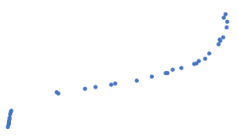

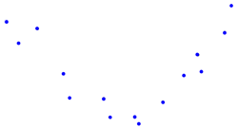
Spearman correlation
Positive Monotonic: tends to increase but not necessarily in a linear fashion.
Negative Monotonic: Tends to decrease but not necessarily in a linear fashion.
Non-Monotonic: No overall tendency to either increase or decrease

Slide 33
Spearman’s Correlation
Spearman’s rho is an excellent choice when you have ordinal data because Pearson’s is not appropriate. Ordinal data have at least three categories and the categories have a natural order. For example, first, second, and third in a race are ordinal data.
For example, imagine the same contestants participate in two spelling competitions. Suppose you have the finishing ranks for all contestants in both matches and want to calculate the correlation between contests. Spearman’s rank order correlation is appropriate for these data.
Spearman’s correlation coefficients range from -1 to +1. The sign of the coefficient indicates whether it is a positive or negative monotonic relationship. A positive correlation means that as one variable increases, the other variable also tends to increase. A negative correlation signifies that as one variable increases, the other tends to decrease. Values close to -1 or +1 represent stronger relationships than values closer to zero.

Slide 34

Calculating Probability
General Multiplication Rule
Use the general multiplication rule to calculate joint probabilities for either dependent or independent events. When you have dependent events, you must use the general multiplication rule because it allows you to factor in how the occurrence of event A affects the likelihood of event B.
Using the standard notation the general multiplication rule is the following:
P(A $⋂$ B) = P(A) * P(B | A)
Or, the joint probability of A&B occurring equals the probability of a occurring multiplied by the conditional probability of B occurring given that a occurred.

Slide 35
Calculating Probability
General Multiplication Rule Example
An example of dependent events is drawing cards from a deck of cards without replacing. As you draw cards it affects the probability of the next card you draw.
Suppose you are interested in the probability of drawing hearts on 2 consecutive draws. Initially the deck has 13 hearts out of its 52 cards (13/52= 0.25). If you draw a heart for event one(event H1) that changes the probability of drawing another heart. The dependent probability of drawing that second heart(event H2) is now 12 /51 = 0.235.
In notation form:
P(H1 ∩ H2) = P(H1) * P(H2|H1)
0.25 * 0.235 = 0.059

Slide 36
Inferential Statistics with Python

Slide 37

Thank you

